Slide 1
Existing problem
Posts and Telecommunication Institute of Technology
Faculty of Information Technology 1
Mathematic discrete1
Ngo Xuan Bach
Dao Thi Thuy Quynh

Slide 2
Contents
Introduction
Reductio ad absurdum method
Dirichlet’s principle
Exercise

Slide 3
Introduce existing problem
Counting problem: Count all combinatorial configurations that satisfy the constrains of problem. The desired solution is to build a formula to find out result of the problem.
Listing problem: Consider all combinatorial configurations that satisfy the constrains of the problem. The solution method usually returns a brute force algorithm (generation algorithm, backtracking algorithm,…)
Optimization problem: Among the combinatorial configurations that satisfy the requirements of problem, choose the solution with the best use value (optimize the objective function)
Existing problem: Consider whether or not there exist combinatorial configurations satisfying the given properties. The solution of the problem is simply to show a combinational configuration that satisfies the given properties or to prove that there is no combinatorial configuration that satisfies the given properties.

Slide 4
Example 1 (1/2)
The problem of 36 officer in army (Euler): 6 regiments are summoned, each regiment has 6 officiers with difference ranks: second lieutenant, lieutenant, first lieutenant, captain, major, lieutenant colonel attend the military parade. Can 36 officers be arranged into a square team so that each horizontal row and each vertical line have representatives of all 6 regiments with 6 different ranks?

Slide 5
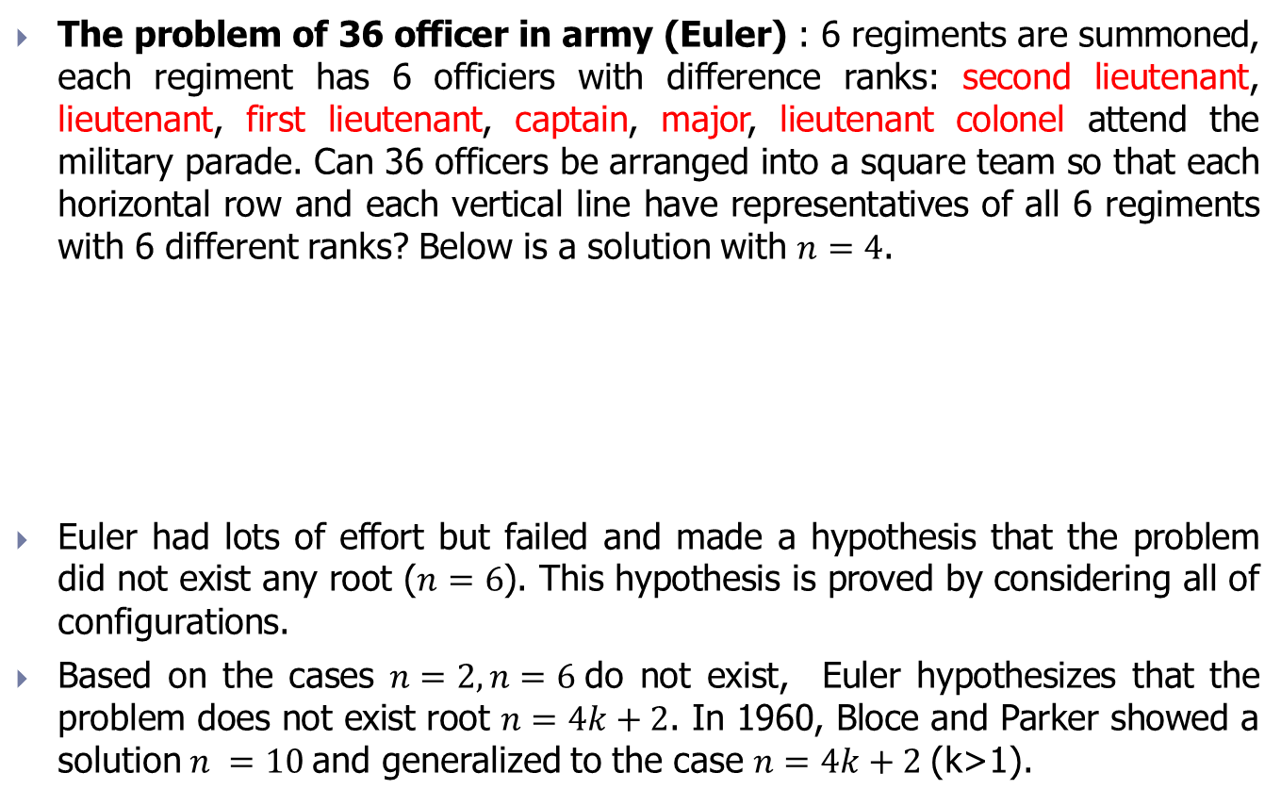
Example 1 (2/2)
The problem of 36 officer in army (Euler) : 6 regiments are summoned, each regiment has 6 officiers with difference ranks: second lieutenant, lieutenant, first lieutenant, captain, major, lieutenant colonel attend the military parade. Can 36 officers be arranged into a square team so that each horizontal row and each vertical line have representatives of all 6 regiments with 6 different ranks? Below is a solution with $n=4$.
Euler had lots of effort but failed and made a hypothesis that the problem did not exist any root ($n=6$). This hypothesis is proved by considering all of configurations.
Based on the cases $n=2, n=6$do not exist, Euler hypothesizes that the problem does not exist root $n=4k+2$. In 1960, Bloce and Parker showed a solution $n =10$and generalized to the case $n=4k+2$(k>1).
Ab | Dd | Ba | Cc
Bc | Ca | Ad | Db
Cd | Bb | Dc | Aa
Da | Ac | Cb | Bd

Slide 6
Example 2 (1/2)
Mystic hexagon problem (Clifford Adams): On the 19 cells of the hexagon, fill in the numbers 1 to 19 so that the sum in the 6 directions of the hexagon is equal (38).

Slide 7
Example 2 (2/2)
Mystic hexagon problem (Clifford Adams): On the 19 cells of the hexagon, fill in the numbers 1 to 19 so that the sum in the 6 directions of the hexagon is equal (38).
After 47 years, Adams found the solution (1957), then because he lost the manuscript, he took another 5 years to recover (1962).
This is also the only solution!!!
15
14
13
9
8
10
6
4
11
5
12
1
2
18
7
16
17
19
3

Slide 8
Contents
Introduction
Reductio ad absurdum method
Dirichlet’s principle
Exercise

Slide 9
Reductio ad absurdum method (1/2)
Idea: Assuming the thing to be proven is false, then using the argument to find out a contradiction.
Example 3: Given 7 segments with lengths greater than 10 and less than 100. Prove that there are always 3 segments that make up a triangle.

Slide 10

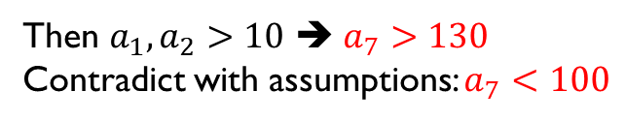
Reductio ad absurdum method (1/2)
Idea: Assuming the thing to be proven is false, then using the argument to find out a contradiction.
Example 3: Given 7 segments with lengths greater than 10 and less than 100. Prove that there are always 3 segments that make up a triangle.
Hint: Let the lengths of the lines be a_1, a_2,…, a_7 (in ascending order)
Assume that no 3 segments join to form a triangle
$$a_{1}+a_{2}≤a_{3},$$
$$a_{2}+a_{3}≤a_{4},$$
$$a_{3}+a_{4}≤a_{5},$$
$$a_{4}+a_{5}≤a_{6},$$
$$a_{5}+a_{6}≤a_{7}$$
Then $a_{1}, a_{2}>10$ ➔ $a_{7}>130$
Contradict with assumptions: $a_{7}<100$

Slide 11
Exercise
Exercise 1: The vertices of a regular hexagon are numbered by arbitrary integers 0,…,9. Prove that there are always 3 consecutive vertices whose sum is greater than 13.
Exercise 2: Prove that it is impossible to connect 31 computers into a network so that each computer is connected to exactly 5 other computers.

Slide 12
Contents
Introduction
Reductio ad absurdum method
Dirichlet’s principle
Exercise

Slide 13
Dirichlet’s principle
Dirichlet’s principle (Rabbit problem)
It is impossible to put 7 rabbits in 3 cages so that each cage contains no more 2 rabbits
Dirichlet’s principle
If put more than n objects in n boxes, always find a box containing no less than 2 objects
Dirichlet’s principle (overview)
If put n objects in k boxes, always find a box containing no less than n/k objects

Slide 14
Example 4 (1/2)
Problem: Prove that in a group of 367 people always find 2 people with the same birthday

Slide 15
Example 4 (2/2)
Problem: Prove that in a group of 367 people always find 2 people with the same birthday
Solution:
The number of days in the year is 365 or 366 (leap year). So, there are a total of 366 different birthdays.
There are 367 people and 366 different birthdays, according to the Dirichlet’s principle, there are 2 people with the same birthday.

Slide 16
Example 5 (1/2)
Problem: There are 5 different types of scholarships. What is the minimum number of students required to make sure that there are at least 6 students receiving the same type of scholarship (assume that all students receive scholarship)?

Slide 17
Example 5 (2/2)
Problem: There are 5 different types of scholarships. What is the minimum number of students required to make sure that there are at least 6 students receiving the same type of scholarship (assume that all students receive scholarship)?
Solution:
Let n be the minimum number of students to ensure that at least 6 students receive the same type of scholarship.
So, n is the smallest integer satisfying n/5 > 5 ➔ n > 25
➔ We need at least n = 25 + 1 = 26 students.

Slide 18
Exercise (Dirichlet)
Exercise 1: Prove that in a meeting room we can always find 2 people who have the same number of friends among the participants.
Exercise 2: In a plane, there are 6 points connected one by one by blue or red arcs. Prove that we can always find 3 points so that the acrs joining them have the same color.
Exercise 3: In a month of 30 days, a volleyball team plays at least one match a day, but there are totally no more 45 matches. Prove that we can find a period including a certain number of consecutive days in a month so that during that period the team plays exactly 14 matches.

Slide 19
Contents
Introduction
Reductio ad absurdum method
Dirichlet’s principle
Exercise

Slide 20
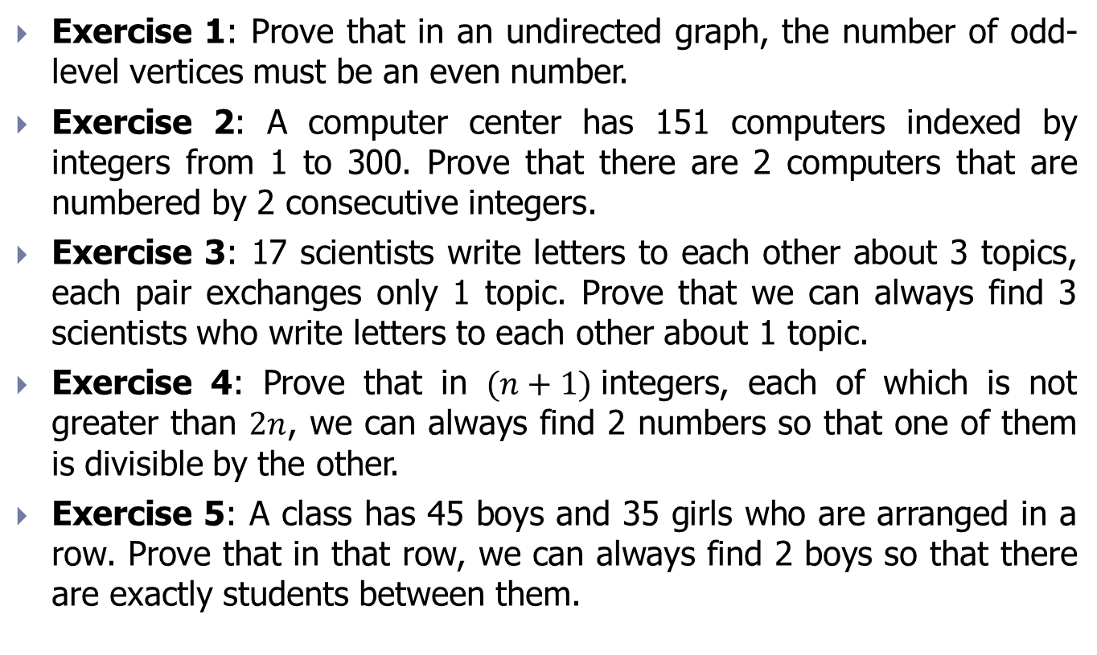
Exercise (Summary)
Exercise 1: Prove that in an undirected graph, the number of odd-level vertices must be an even number.
Exercise 2: A computer center has 151 computers indexed by integers from 1 to 300. Prove that there are 2 computers that are numbered by 2 consecutive integers.
Exercise 3: 17 scientists write letters to each other about 3 topics, each pair exchanges only 1 topic. Prove that we can always find 3 scientists who write letters to each other about 1 topic.
Exercise 4: Prove that in $(n+1)$integers, each of which is not greater than $2n$, we can always find 2 numbers so that one of them is divisible by the other.
Exercise 5: A class has 45 boys and 35 girls who are arranged in a row. Prove that in that row, we can always find 2 boys so that there are exactly students between them.

Slide 21
Exercise (Summary)
Exercise 6: Prove that among any 10 people, we can always find either 2 people whose sum of ages is divisible by 16, or 2 people whose distance of ages is divisible by 16
Exercise 7: In space, there are 9 integers coordinate points. Prove that there are 2 points whose line segment connecting them goes through at least 1 other integer coordinate point.
Exercise 8: How many at least ordered sets of 2 integers (a,b) so that we can always choose 2 sets (c,d) and (e,f) satisfying c-e and d-f are numbers that have digit 0 at the end?
Exercise 9: Let 13 mantises on a 5x5 chessboard so that each square has no more than 1 mantis and no 2 mantis in 2 adjacent cells. A person knocks a bowl, each time the bowl is knocked, the manties will move to the next cell (up, down, left, right). Prove that after 2015 times of knocking the bowl, there exists at least 1 cell having more than 1 mantis.

